Slide 1
ELEN 21/COEN 21: Introduction to Logic Design
Lectures 3 & 4: Karnaugh Maps
Radhika S. Grover
Electical Engineering Department
Santa Clara University
rgrover@scu.edu

Slide 2
Overview
3,4,5 variable Kmaps
NAND-NAND implementations
Multi-level NAND
Multiple output circuits

Slide 3
Lecture 3: Gate-level minimization
Karnaugh map or K-map: simple procedure for minimizing Boolean functions.
Simplified expressions produced by the map are always in sum of products form or product of sums form.
This produces a circuit diagram with a minimum number of gates and a minimum number of inputs to gates.

Slide 4
Representation of functions in two-variable map
x
1
x
2
x
x
1
0
0
m
2
0
1
0
0
1
m
1
0
m
0
m
2
1
0
m
2
1
m
1
m
3
1
1
m
3
(a) Truth table
(b) Karnaugh map

Slide 5
Two-variable map
1

Slide 6
Three-variable map

Slide 7
Karnaugh map
x
1
x
2
x
3
00
01
11
10
0
1
1
1
1
f
=
x
3
+
x
1
x
2
1
0
0
0
1

Slide 8
Exercise
Simplify the Boolean function F(x, y, z) = ∑(2, 3, 4, 5)
Steps:
Mark a 1 in each minterm that represents the function.
Find possible adjacent squares (can use: 1, 2, 4, 8, 16 adjacent squares).
Represent the product terms in adjacent squares.
Logical sum of these gives solution.

Slide 9
Exercise
Simplify the Boolean function F(x, y, z) = ∑(3, 4, 6, 7).
Simplify the Boolean function using 3-variable Kmaps: xy+x’y’z’+x’yz’

Slide 10
Exercise
Given the Boolean function F = A’C + A’B + AB’C + BC
Express it in sum of minterms
Find minimal sum of products expression.

Slide 11
Four-variable map

Slide 12
Example
Simplify the Boolean function F(w, x, y, z) = ∑(0, 1, 2, 4, 5, 6, 8, 9, 12, 13, 14)

Slide 13
Prime Implicants
Prime implicant: is a product term obtained by combining the maximum possible number of adjacent squares in the map.
If a minterm in a square is convered by only one prime implicant, that prime implicant is said to be essential.

Slide 14
Simplification using prime implicants
Simplify the Boolean function F(A, B, C, D) = ∑(0, 2, 3, 5, 7, 8, 9, 10, 11, 13, 15).
There is only one way to include minterms m₀ and m₅ – gives essential prime implicants.
There is more than one way to cover minterms m₃, m₉ amd m₁₁.

Slide 15
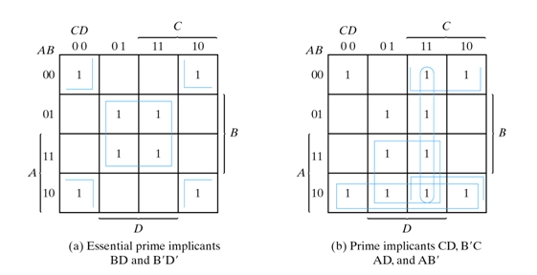
Simplification using prime implicants

Slide 16
Five-variable Map
Consists of two 4-variable maps

Slide 17
Exercise
Find all prime implicants for the Boolean function and determine which are essential:
F(w, x, y, z) = ∑(0, 2, 4, 5, 6, 7, 8, 10, 13, 15)
Simplify the Boolean function
F(A, B, C, D, E) = ∑(0, 2, 4, 6, 9, 13, 21, 23, 25, 29, 31)
Solution : A’B’E’+BD’E+ACE

Slide 18
Product of sums simplification
Procedure for obtaining minimized function in product of sums form:
Mark empty squares by 0’s.
Combine them into valid adjacent squares : give complement of function i.e. F’.
Use generalized DeMorgan’s theorem to get back F.

Slide 19
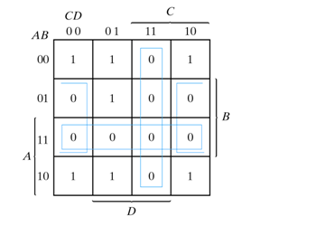
Example 3
Simplify F(A, B, C, D) = ∑(0, 1, 2, 5, 8, 9, 10) in product of sums form.

Slide 20
Don’t care conditions
There are some applications where function is not specified for certain combinations of variables.
E.g. 4-bit binary code for the decimal digits has 6 combinations that are not used.
These unused function values are called don’t care conditions, and can be marked as 1 or 0, and used to simplify K-map.

Slide 21
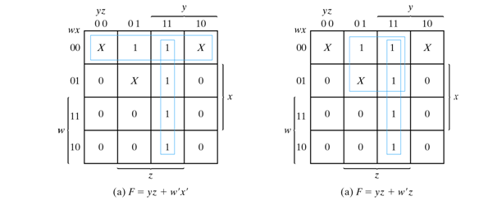
Example
Simplify the Boolean function F(w, x, y, z) = ∑(1, 3, 7, 11, 15)
with the don’t-care conditions: d(w, x, y, z) = ∑(0, 2, 5)

Slide 22
NAND and NOR implementation
Digital circuits are frequently constructed with NAND or NOR gates (than AND and OR gates)
- NAND and NOR are easer to fabricate.
Convert Boolean functions given in terms of AND, NOT and OR into equivalent NAND and NOR diagrams.

Slide 23
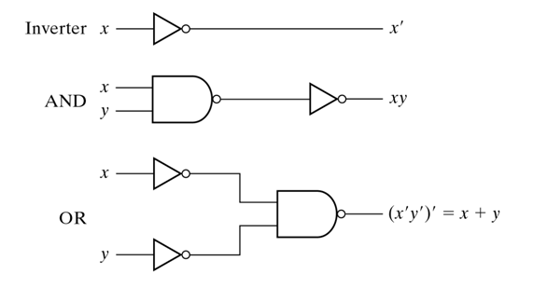
Logic Operations with NAND gates

Slide 24
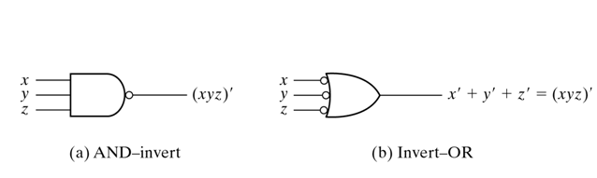
Two graphic symbols for NAND gate

Slide 25
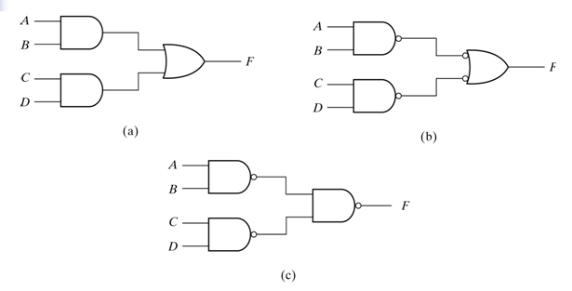
Implement F=AB+CD using NAND

Slide 26
Procedure for obtaining 2-level NAND gate logic diagram from a Boolean function
Simplify the function and express it in sum of products.
First-level: Draw a NAND gate for each product term of the expression that has at least two literals. The inputs to each NAND gate are the literals of the term.
Second-level: Draw a single gate using the AND-invert or the invert-OR graphic symbol with inputs coming from inputs of first-level gates.
Term with a single literal: complement it and connect it directly to an input of the second-level NAND gate.

Slide 27
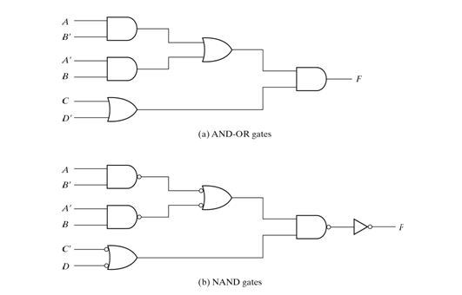
Multi-level NAND circuits

Slide 28
Converting AND-OR circuit into an all-NAND diagram
Procedure:
Convert all AND gates to NAND gates with AND-invert graphic symbols.
Convert all OR gates to NAND gates with invert-OR graphic symbols.
Check all bubbles in the diagram. For every bubble that is not compensated by another small circle along same line, insert an inverter or complement the input literal.

Slide 29
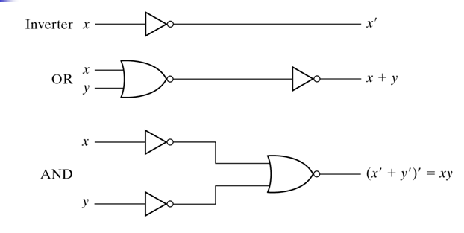
Logic Operations with NOR Gates

Slide 30
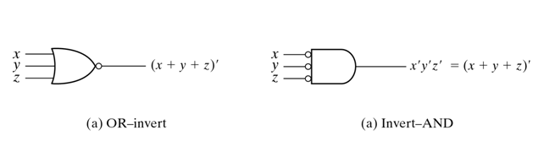
Graphic symbols for NOR gates

Slide 31
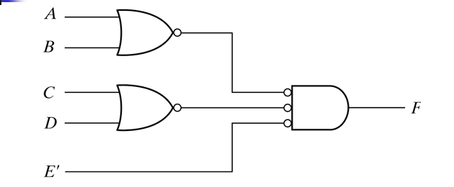
Implementing functions with NOR gates
Implement F= (A+B)(C+D)E with NOR gates

Slide 32
Degenerate forms
What are different two-level combinations with AND, OR, NAND, NOR gates?
Eight of these have same gate at both levels eg. NAND-NAND called degenerate.
The other eight are called nondegenerate and produce an implementation in product of sums or sum of products.
Notes:
Nondegenerate forms produce SOP or POS
AND-OR
OR-AND
AND-NOR
OR-NAND
NOR-OR
NOR-NOR
NAND-NAND
NAND-AND
Degenerate forms:
AND-AND : AND
OR-OR: OR
AND-NAND: NAND
NAND-OR: OR
And others

Slide 33
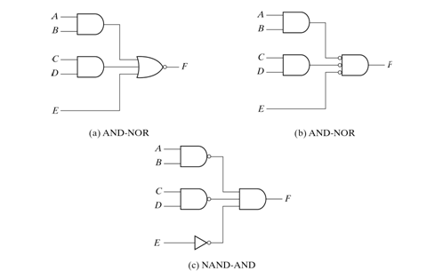
AND-OR-INVERT implementation

Slide 34
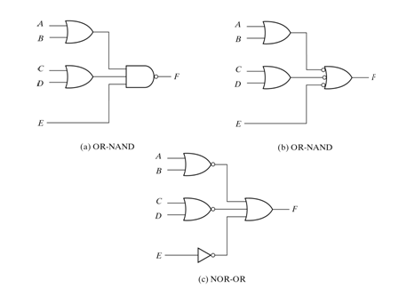
OR-AND-INVERT implementation

Slide 35
EXCLUSIVE-OR (XOR) FUNCTION
XOR function has symbol:
It performs the following Boolean operation:
x y = xy’ + x’y
The exclusive-NOR gates (or equivalence) performs the following Boolean operation:
(x y)’ = (xy’ + x’y)’ = xy + x’y’

Slide 36
XOR Truth Table
A
Output
B
A
B
Output
0
0
0
0
1
1
1
0
1
1
1
0

Slide 37
Exercise: Implement XOR with AND-OR-NOT gates, and only NAND gates

Slide 38
ODD FUNCTION
Odd function: The output of the function is a 1 only if an odd number of variables are equal to 1.
Example: 3-variable XOR function:
A B C = ∑(1, 2, 4, 7)
Even function: The complement of an odd function is an even function.

Slide 39
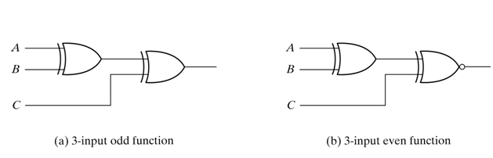
Logic Diagram of Odd and Even functions

Slide 40
Multiple-output circuits
Share portions of circuits between different functions.
Find implicants (not necessarily prime) that can be shared between functions.

Slide 41
Exercise
Find the minimum cost realization of:
f3 = x1’x4+x2x4+x1’x2x3
f4 =x1x4+x2’x4+x1’x2x3x4’

Slide 42
Solution
Solution to the problem on the previous slide:
f3 = x1x2x4+x1’x2x3x4’+x1’x4
f4= x1x2x4+x1’x2x3x4’+x2’x4

Slide 43
Summary
Simplification using K-maps
Degenerate forms
Multiple output circuits

